Slide 1

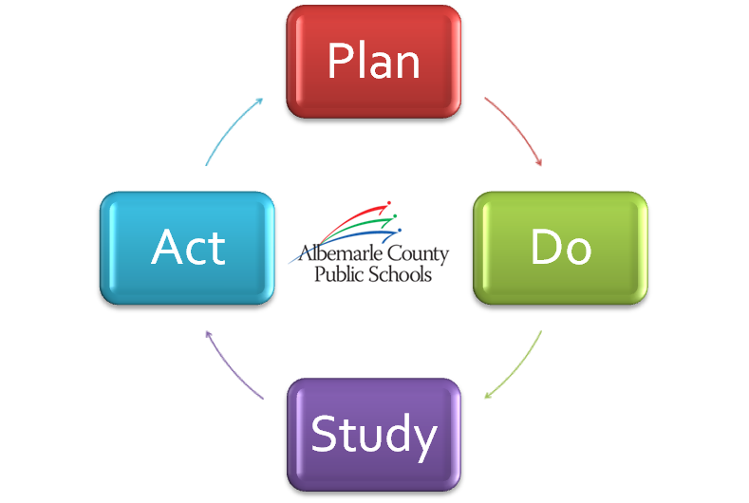
Board Work Session
Academic Excellence Scorecard
November 29, 2012

Slide 2
Drafting a Benchmark Scorecard
Albemarle County School Board Priority 4.3:
Assemble a collection of rigorous performance indicators and recognized benchmarks that define a world-class educational system.

Slide 3

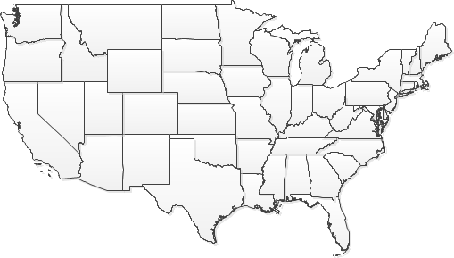
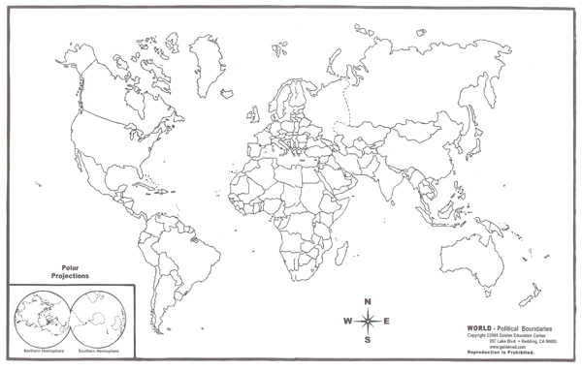
Assumptions
Assemble: bring together a few key measures that we currently use or are readily available.
Rigorous: the measure will push us to learn above and beyond the expected.
World Class: the measure will allow us to benchmark performance beyond our locality (county, region, state).
Ethical: our selected benchmarks will foster principled decisions to do what is right for our school community.
This is not intended to add more standardized tests or to increase our emphasis on them

Slide 4
State and National Focus
National
State
Division Stakeholders
School
Teacher
Student
Academic Excellence Scorecard
Focus on State & National Benchmarks

Slide 5
Why Benchmark?
Build credibility and value with our community.
Our Performance Compared to Others
Common Language
Avenue for Learning
Prioritize our Efforts

Slide 6
Measuring Our Mission
Establishing a community of learners and learning through relationships, relevance
and rigor, one student
at a time
What students will know, understand, and be able to do
Rigor of curriculum
Quality Learning Experience for one learner
Why students will learn this content
Relevance of content
What students will use to
learn (as well as when, where, and with whom)
Relationships to learning resources
Notes:
If we think back to the Walton example I just used with the last slide, we can see that as moved on one scale, whether it be Relationships, Relevance or Rigor, the other elements of providing Quality Learning Experiences began to move as well. The diagram in this example illustrates this 3 dimensional idea. In order to get to the Quality Learning experience for all students, we have to move on all three scales. Not one of these elements alone will get us to that Quality Learning Example. The interesting piece here as well is that as we move further down one of the axes, the volume of the box or experience for the students will increase as well. Think about the Greern 5th grade Expeditionary Learning experience several years ago. As they researched the life of Mary Carr Greer and explored the history of the school, learning took on a new meaning. Rigor took on a new meaning as students engaged in analytical reading and writing as they conducted research. Relationships definitely took on a new meaning. The Relevance of the work was very meaningful as they were studying their own community and school. Students worked collaboratively, they interview and interacted with many community members, they used technology and other tools to do they work and they created a new learning space in the halls of their school. Just an example that I hope helps the understanding that in order to establish quality learning experiences for all students and to establish a community of learners and learning that this can only be accomplished through Rigor, Relevance and Relationships.

Slide 7
How do we select benchmark data?
We first need valid and reliable measurements that are associated with our strategic goals and desired curricular outcomes
Further, we want to be ethical in our choices and how we use the data generated for comparisons with other districts
Notes:
How do we select benchmark data? In order to adequately study our results, we first need good measurements that are associated with Albemarle County School Division Goals and desired curricula outcomes. If we don’t start with good data, we will not have good information in order to make good decisions.

Slide 8
Bloom’s Taxonomy & Ethical Considerations
Eval
Knowledge
Comprehension
Application
Analysis
Synthesis
Applying
Understanding
Remembering
Analyzing
Evaluating
Creating
1956
1990’s
Notes:
Have you ever thought about how Bloom’s Taxonomy applies to teaching ethics?
Well, before we do that, please consider two versions of Bloom’s taxonomy for cognition.
Please think about and write down one similarity between the two and one difference.
Solicit. Seek to label at a particular level of the taxonomy.
Bloom's Taxonomy
New Version
In 1956, Benjamin Bloom headed a group of educational psychologists who developed a classification of levels of intellectual behavior important in learning. During the 1990's a new group of cognitive psychologists, lead by Lorin Anderson (a former student of Bloom), updated the taxonomy to reflect relevance to 21st century work. The two graphics show the revised and original Taxonomy. Note the change from nouns to verbs associated with each level.
Note that the top two levels are essentially exchanged from the traditional to the new version.
Old Version
Remembering: can the student recall or remember the information? define, duplicate, list, memorize, recall, repeat, reproduce state Understanding: can the student explain ideas or concepts? classify, describe, discuss, explain, identify, locate, recognize, report, select, translate, paraphrase Applying: can the student use the information in a new way? choose, demonstrate, dramatize, employ, illustrate, interpret, operate, schedule, sketch, solve, use, write. Analyzing: can the student distinguish between the different parts? appraise, compare, contrast, criticize, differentiate, discriminate, distinguish, examine, experiment, question, test. Evaluating: can the student justify a stand or decision? appraise, argue, defend, judge, select, support, value, evaluate Creating: can the student create new product or point of view? assemble, construct, create, design, develop, formulate, write.

Slide 9
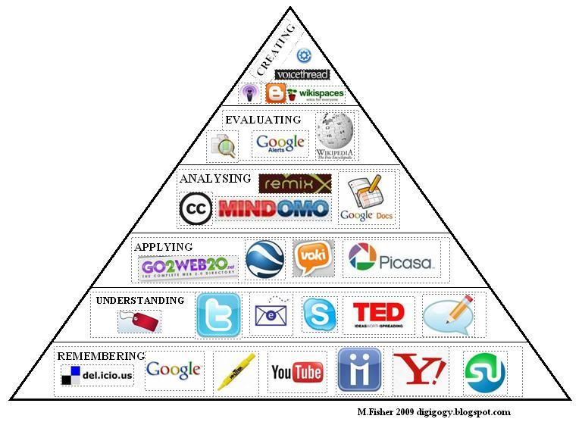
Bloom’s Taxonomy
Notes:
Consider how these tools can help students accomplish different levels of cognition.
How do the different levels of cognition help students use these tools?
Ethics?

Slide 10
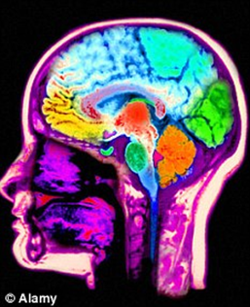
Ethical Consideration
Which level of Bloom’s Taxonomy requires the greatest ethical consideration?
The moral compass, technically named the right temporo-parietal junction, lies just behind the right ear in the brain.
Notes:
The brain is one of the largest and most complex organs in the human body.
It is made up of more than 100 billion nerves that communicate in trillions of connections called synapses.
The brain is made up of many specialized areas that work together:
• The cortex is the outermost layer of brain cells. Thinking and voluntary movements begin in the cortex.
• The brain stem is between the spinal cord and the rest of the brain. Basic functions like breathing and sleep are controlled here.
• The basal ganglia are a cluster of structures in the center of the brain. The basal ganglia coordinate messages between multiple other brain areas.
• The cerebellum is at the base and the back of the brain. The cerebellum is responsible for coordination and balance.
The brain is also divided into several lobes:
• The frontal lobes are responsible for problem solving and judgment and motor function.
• The parietal lobes manage sensation, handwriting, and body position.
• The temporal lobes are involved with memory and hearing.
• The occipital lobes contain the brain's visual processing system.
The brain is surrounded by a layer of tissue called the meninges. The skull (cranium) helps protect the brain from injury.

Slide 11
When identifying performance indicators consider…
What are the key metrics?
How can we ensure that we are working with quality and meaningful data?
How do we strike a balance between the quality control business model and a more holistic and evidentiary approach to evaluating our work?
What are the ethical considerations we should take into account when choosing performance indicators and our response to reports?
How do our choices communicate our curriculum: The ACPS Lifelong-Learner Standards and Framework for Quality Learning?

Slide 12
In reviewing a specific indicator, consider…
How will this metric demonstrate accomplishment? What has been accomplished?
How will this metric help us demonstrate progress?
What makes this a world-class indicator?

Slide 13
Example
College Work Readiness Assessment (CWRA)
An assessment that tests high school students on their 21st century skills of critical thinking, analytic reasoning, problem solving, and written communication.
Skills that are necessary in work and college environments in the 21st century.
Tests are completed online in a proctor format and are suggested for freshmen and seniors in high school.

Slide 14
CWRA Background
Council for Aid to Education
Description, Participation, and FAQ
Teaching to a Test Worth Teaching To
Assessing Critical Thinking, Analytical Reasoning, Problem-Solving and Writing in High School
Sample Report

Slide 15
CWRA Reports
Three perspectives are offered:
College Readiness
Comparison of high school seniors across participating CWRA schools
Effect Size / Valuation through a value added score

Slide 16
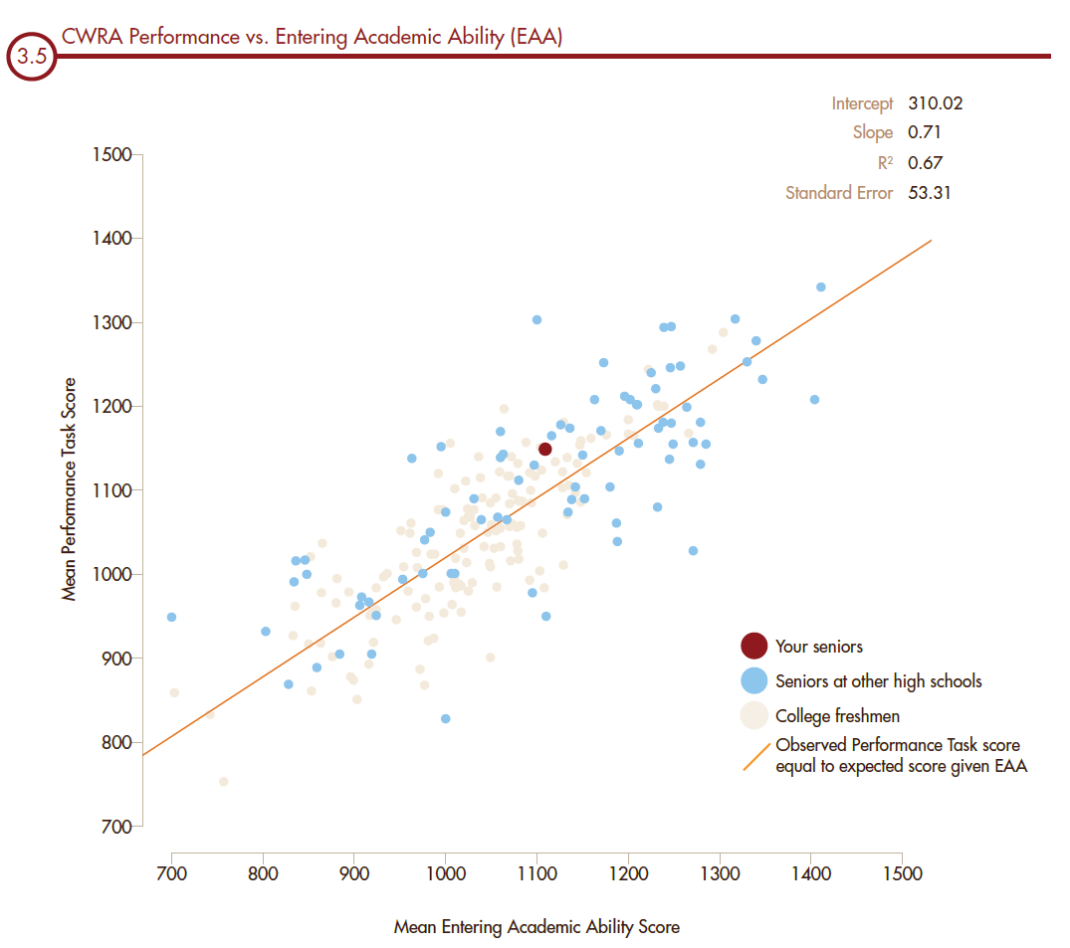
Benchmarking

Slide 17
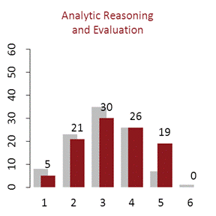
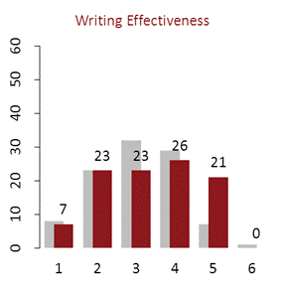
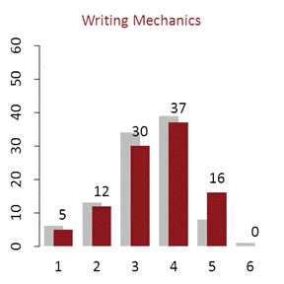
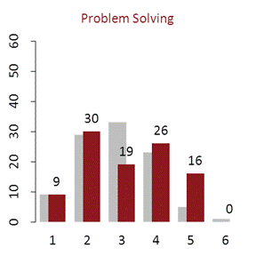
AHS Seniors’ Distribution of Subscores
 | Analytic Reasoning & Evaluation |  |  | Writing Effectiveness |  |  | Writing Mechanics |  |  | Problem Solving
 | Your School | All Schools |  | Your School | All Schools |  | Your School | All Schools |  | Your School | All Schools
Mean | 3.3 | 3 |  | 3.3 | 3 |  | 3.5 | 3.3 |  | 3.1 | 2.9
Standard Deviation | 1.1 | 0.9 |  | 1.2 | 0.9 |  | 1.1 | 0.9 |  | 1.3 | 0.9
Benchmarking

Slide 18
Guiding Questions for CWRA Example
How can we use the CWRA for Continuous Improvement?
How does the CWRA align to our LLLS?
What does this indicator tell us about how we prepare our high school students?
What indicator might inform what they want to know?
What do our stakeholders want to know about our high school students?
Eval
Knowledge
Comprehension
Application
Analysis
Synthesis

Slide 19
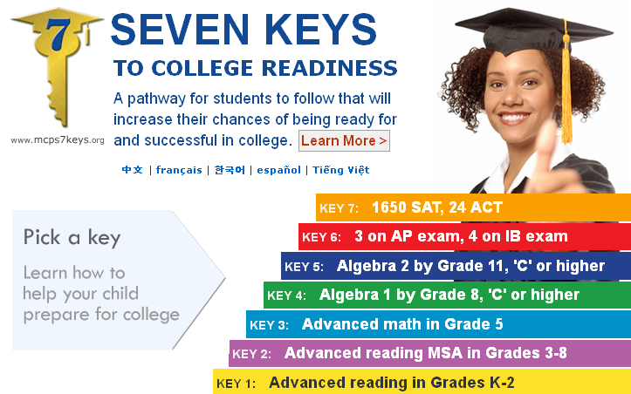
Consider a Hierarchy
Each benchmark contributing to the next to develop a child from early elementary school through high school to college, career, and citizenship readiness
Notes:
Rather than choosing isolated indicators, we propose a hierarchy: each benchmark contributing to the next to develop a child from early elementary school through to college, career, and citizenship readiness.
The pathway to college and a career begins in kindergarten, and our proposal is to provide highlight points that sequentially build to open doors to college for students. It is our intention that students who meet each benchmark along the way will be more likely to be ready for college and better prepared to earn a four-year college degree. In terms of valuation, a college education pays; the average high school graduate will earn $1.2 million over his or her lifetime, compared with $2.1 million that the average college graduate will make.
Our measurements should be rigorous and demanding to prepare students to take and do well in college-level classes or prepare them for the workplace, where higher-level skills are necessary. These measurements should also be demanding for our schools and school system, requiring us to learn and grow and improve to meet our students’ needs.

Slide 20

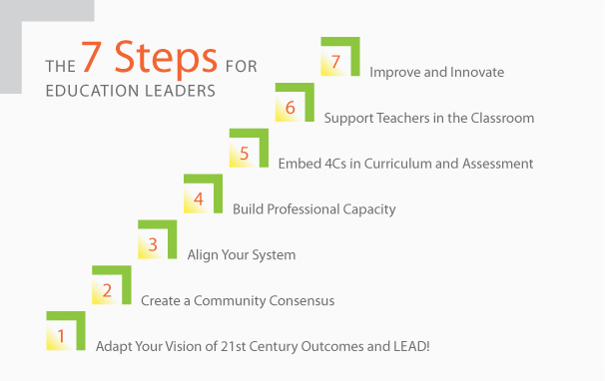
Consider Division-Level Quality Indicators
Measuring our school system against others using the same criteria can help us focus on critical aspects of our performance and identify areas for growth.
More importantly, we can learn from our peers.
Notes:
No matter the size or nature of your organization, the Criteria are a guide in your journey toward performance excellence. They can help your organization align resources; improve communication, productivity, and effectiveness; and achieve strategic goals.
The Criteria work as an integrated framework for managing an organization. They are simply a set of questions focusing on critical aspects of management that contribute to performance excellence:
Leadership
Strategic planning
Customer focus
Measurement, analysis, and knowledge management
Workforce focus
Operations focus
Results
The Criteria serve two main purposes:
Identify Baldrige Award recipients to serve as role models for other organizations
Help organizations assess their improvement efforts, diagnose their overall performance management system, and identify their strengths and opportunities for improvement

Slide 21
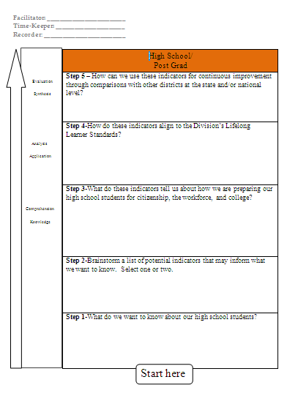
Breakout Session Overview
45 Minutes
Facilitator, Time Keeper, Recorder in each group
Complete graphic organizer for academic indicators in elementary, middle, high, and Division
Reconvene and Report Out

Slide 22
Breakout Sessions
COB 235 (Elementary)
  Robyn Bolling, Debbie Collins, Mark Green, Rosaura Gonzalez-Muniz, Laura Dewald Richardson
COB 246 (Middle)
  Chris Gilman, Billy Haun, Peter Henning, Jill Sochor, Jon Wamsley
COB 241 (High)
  Matt Haas, Melisa Larson,Bonnie Pendleton, Karen Redd, Jesse Turner

